Slide 1
this

Slide 2
Outline
In this lesson, we will:
See how to access the address of an object
Look at where this is used

Slide 3
Addresses
We can always access the address of a variable by taking its address:
#include <iostream>
int main();
void print_value( int n ); // pass by value
void print_reference( int &n ); // pass by reference
int main() {
int n;
std::cout << &n << std::endl;
print_reference( n );
print_value( n );
}
void print_reference( int &n ) {
std::cout << &n << std::endl;
}
void print_value( int n ) {
std::cout << &n << std::endl;
}
Output:
0x7ffffb6cdd4c
0x7ffffb6cdd4c
0x7ffffb6cdd2c
Get the address of n
Pass the argument n by reference
Get the address of the argument n
The parameter n taking the value of the argument
Get the address of the parameter n

Slide 4
Addresses
Inside a member function, how do we access the address of the object the member function is being called on?
class Vector_3d;
class Vector_3d {
public:
void print_address() const;
private:
double x;
double y;
double z;
};
void Vector_3d::print_address() const {
std::cout << ??? << std::endl;
}
int main() {
Vector_3d v{};
std::cout << &v << std::endl;
v.print_address();
return 0;
}

Slide 5
Implied parameter
Every time you call a member function, there is an implied member variable this
It is assigned the address of the object on which the member function is called
This identifier is a keyword, but it is also a local variable
The type is always
Class_name *const this;
Focusing on Class_name *const this we see that we cannot assign to this

Slide 6
Addresses
For example, we can now print this value:
#include <iostream>
// Declarations
class Vector_3d;
int main();
// Class definition
class Vector_3d {
// ...
};
int main() {
Vector_3d v{};
std::cout << &v << std::endl;
v.print_address();
return 0;
}
void Vector_3d::print_address() const {
std::cout << this << std::endl;
}
Output:
0x7ffd349b2ac0
0x7ffd349b2ac0

Slide 7
Addresses
If we use dynamic memory allocation, the result is the same:
#include <iostream>
// Declarations
class Vector_3d;
int main();
// Class definition
class Vector_3d {
// ...
};
int main() {
Vector_3d *p_v{new Vector_3d{}};
std::cout << p_v << std::endl;
p_v->print_address();
return 0;
}
void Vector_3d::print_address() const {
std::cout << this << std::endl;
}
Output:
0x1969010
0x1969010

Slide 8
Using this
On occasion, a programmer may be tempted to use this inside a member function:
double Vector_3d::norm() const {
return std::sqrt(
this->x*this->x + this->y*this->y + this->z*this->z
);
}
instead of the clearer
double Vector_3d::norm() const {
return std::sqrt(x*x + y*y + z*z);
}
Please don’t do this; or if you do, please don’t acknowledge you studied at the University of Waterloo

Slide 9
Using this
There are occasional reasons to use this in this manner:
For example, suppose you declared a local variable (why?!) with the same name as a member variable
double Vector_3d::norm() const {
double x{y*y + z*z};
return std::sqrt( this->x*this->x + x );
}
Local variable
Member variable

Slide 10
Using this
Another situation is when you need a unique number associated with an instance of an object:
We call this a hash value
unsigned long Vector_3d::hash() const {
unsigned long hash_value{reinterpret_cast<unsigned long>( this )};
return 11400714819323198549*hash_value;
}
Because n = 11400714819323198549 is prime,
it follows that n and 2⁶⁴ are relatively prime (no common factors)
Therefore, two different addresses (and thus two different objects) will have two different hash values
This gives a unique number without revealing the address
Interpret the address stored in this as an unsigned long

Slide 11
Using this
Finally, you will use this in programming data structures such as trees
You may have to assign to a member variable in a different object the value of this object’s address
Sort-of like giving out your business card

Slide 12
Communication
A class where instances can be paired up, allowing each to deliver information to the other
class Messenger {
public:
Messenger();
Messenger( Messenger &partner );
bool send( int msg );
int receive();
private:
Messenger *p_partner;
int message;
bool received;
};

Slide 13
Communication
Messenger::Messenger():
p_partner{nullptr}, // No partner
received{false} {
// empty constructor
}
Messenger::Messenger( Messenger &partner ):
p_partner{&partner}, // Store the address of my partner
received{false} {
// If the partner already has a partner, 'unfriend' that
// partner first--otherwise, we'll be in trouble...
if ( parnter.p_partner != nullptr ) {
parnter.p_partner->p_partner = nullptr;
}
partner.p_partner = this; // Let the partner know about me
}
Important: partner is an instance of this
class, so this constructors can access and
modify its member variables

Slide 14
Communication
bool Messenger::send( int msg ) {
if ( (p_partner == nullptr) || (p_partner->received) ) {
return false;
} else {
p_partner->message = msg;
p_partner->received = true;
return true;
}
}
int Messenger::receive() {
if ( received ) {
int msg = message;
received = false;
return msg;
} else {
return -1;
}
}
Recall: short-circuit evaluation!
Important: p_partner is the address of an
instance of this class, so this member function
can modify its member variables

Slide 15
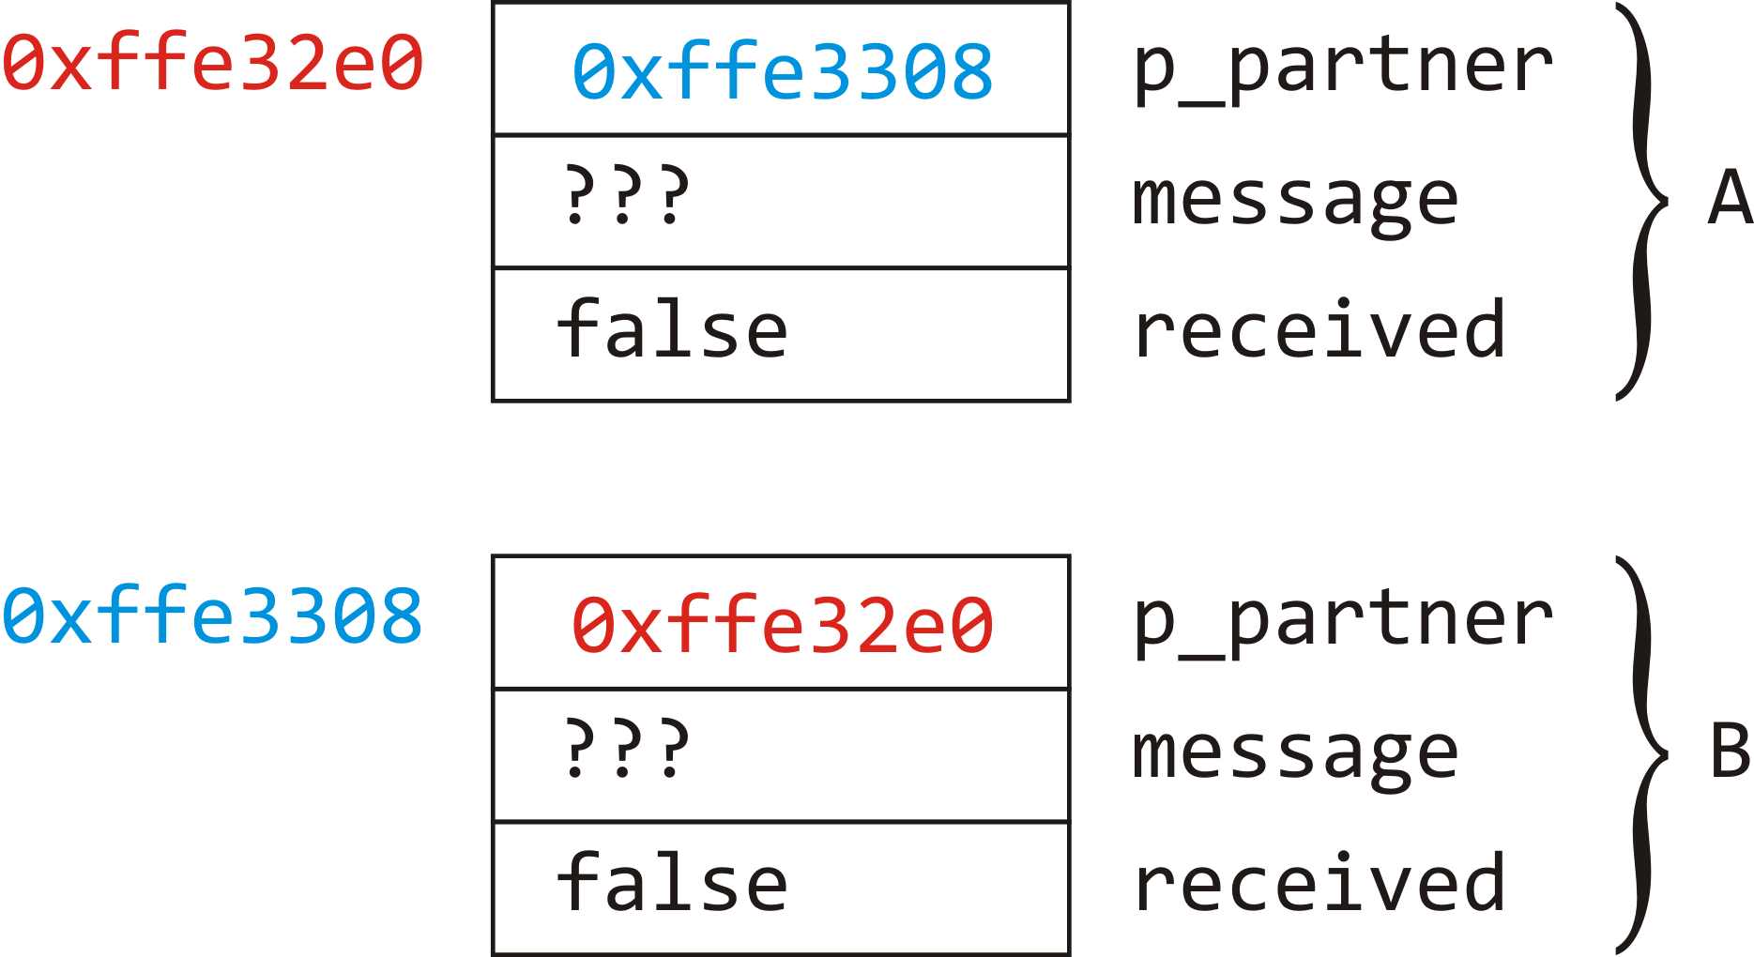
Communication
int main() {
Messenger A{}; // 'A' has no partner at this point
Messenger B{A}; // 'A' and 'B' are now partnered up
// ...
return 0;
}

Slide 16
Communication
int main() {
Messenger A{}; // 'A' has no partner at this point
Messenger B{A}; // 'A' and 'B' are now partnered up
for ( int k{0}; k < 25; ++k ) {
int msg{};
int choice{rand() % 4};
if ( choice == 0 ) {
std::cout << "A sending" << k << std::endl;
if ( !A.send( k ) ) {
std::cout << " - message not sent..." << std::endl;
}
} else if ( choice == 1 ) {
std::cout << "B sending" << k << std::endl;
if ( !B.send( k ) ) {
std::cout << " - message not sent..." << std::endl;
}

Slide 17
Communication
} else if ( choice == 2 ) {
msg = A.receive();
if ( msg == -1 ) {
std::cout << " - not received..." << std::endl;
} else {
std::cout << " - received " << msg << std::endl;
}
} else {
assert( choice == 3 );
std::cout << "B receiving:" << std::endl;
msg = B.receive();
if ( msg == -1 ) {
std::cout << " - not received..." << std::endl;
} else {
std::cout << " - received " << msg << std::endl;
}
}
}
return 0;
}

Slide 18
Communication
B receiving:
- not received...
A receiving:
- not received...
B sending 2
B receiving:
- not received...
B sending 4
- message not sent...
B receiving:
- not received...
A receiving:
- received 2
A sending 7
B sending 8
B sending 9
- message not sent...
A receiving:
- received 8
B receiving:
- received 7
A receiving:
- not received...
B receiving:
- not received...
B receiving:
- not received...
A receiving:
- not received...
A sending 16
A receiving:
- not received...
A sending 18
- message not sent...
A sending 19
- message not sent...
B receiving:
- received 16
A sending 21
B receiving:
- received 21
B sending 23
A receiving:
- received 23

Slide 19
Question
Does this class require a destructor? If so, what should it do? Why?
class Messenger {
public:
Messenger();
Messenger( Messenger &partner );
~Messenger();
bool send( int msg );
int receive();
private:
Messenger *p_partner;
int message;
bool received;
};

Slide 20
Summary
Following this lesson, you now
Know that each time you call a member function, this is assigned the address of the object on which it was called
Understand that the declaration is Class_name *const this
Understand some applications:
If a local variable has the same name as a member variable
If you need a unique hash value
When you must store your address in the member variable of another object
Have seen an application for two objects communicating

Slide 21
References
[1] No references?

Slide 22



Colophon
These slides were prepared using the Georgia typeface. Mathematical equations use Times New Roman, and source code is presented using Consolas.
The photographs of lilacs in bloom appearing on the title slide and accenting the top of each other slide were taken at the Royal Botanical Gardens on May 27, 2018 by Douglas Wilhelm Harder. Please see
https://www.rbg.ca/
for more information.

Slide 23
Disclaimer
These slides are provided for the ece 150 Fundamentals of Programming course taught at the University of Waterloo. The material in it reflects the authors’ best judgment in light of the information available to them at the time of preparation. Any reliance on these course slides by any party for any other purpose are the responsibility of such parties. The authors accept no responsibility for damages, if any, suffered by any party as a result of decisions made or actions based on these course slides for any other purpose than that for which it was intended.

